Slide 1


Supply Chain Reaction: The Vicious Cycle
Definitions:
DTD/DTP – Dock to Dock/Dock to Port
CRF – Customer Arranged Shipping
V555_* - Customer followed by customer number
Average Rate – Average charge by the port
Unit Quantity – The number of units ordered
Plant – Where the manufacturing of goods occur
Notes:
Supply chain is the movement of goods from plant to customer, everything in between.
I describe supply chain like the links in a chain, if one of them is weak or breaks, the chain falls or is weakened.
This dataset shows shortfalls, unusual data, and opportunities for improvement or growth

Slide 2
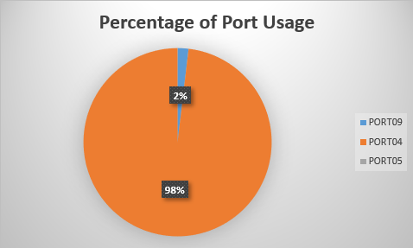
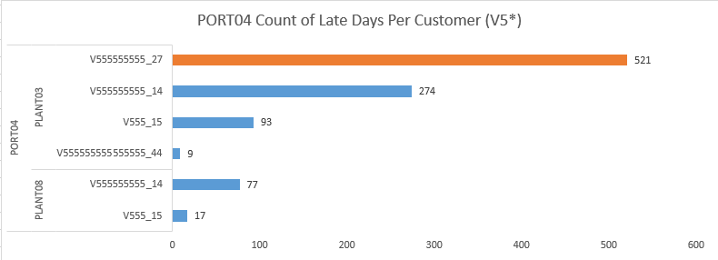
Excessive usage of PORT04 may be causing late deliveries.

Slide 3
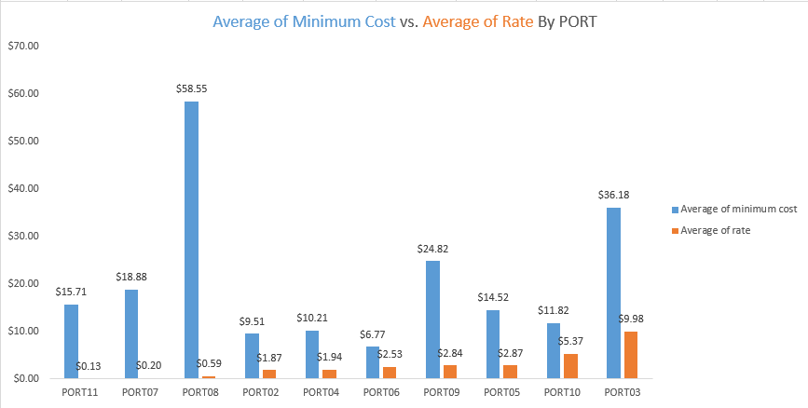
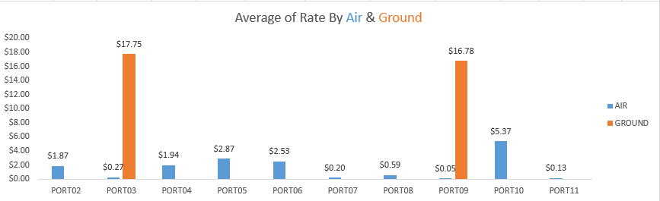
Average rates/cost show some alarming results.

Slide 4
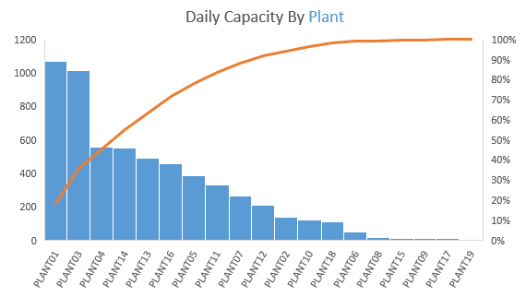
Capacity, whether intended or not, seems to depend on just two plants.

Slide 5
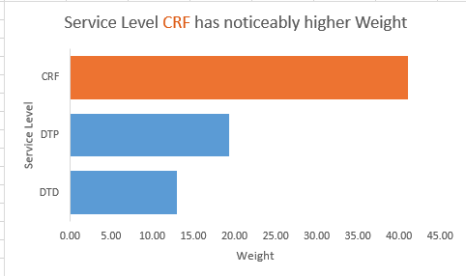
Opportunity to pass savings cost on to your best customers.

Slide 6
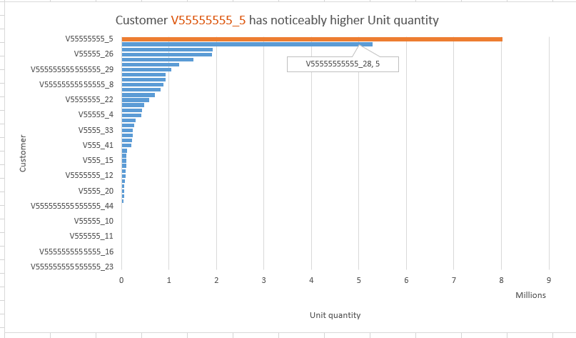
Establish a working relationship with your best customers.

Slide 7
Conclusion
Evaluate the usage of the ports
Figure out ways to lower days late by customer importance
Costs should be evaluated even if no changes are to be made
Monitor plant capacity
Establish professional relationships with your biggest customers
Supply chain will continue to have hardships for the foreseeable future

